Slide 1
Trajectory Optimization for an Inertia Wheel Cube
Ethan Weber
MIT

Slide 2
Inspiration
M-Blocks (CSAIL)
Cubli (ETH Zurich)
http://hplusmagazine.com/wp-content/uploads/2014/05/m-blocks.jpg
http://www.idsc.ethz.ch

Slide 3
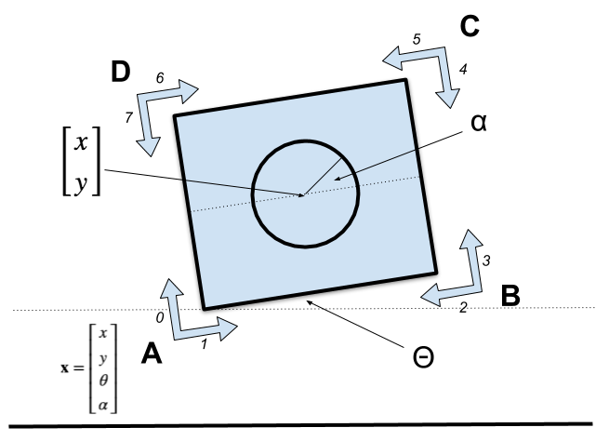
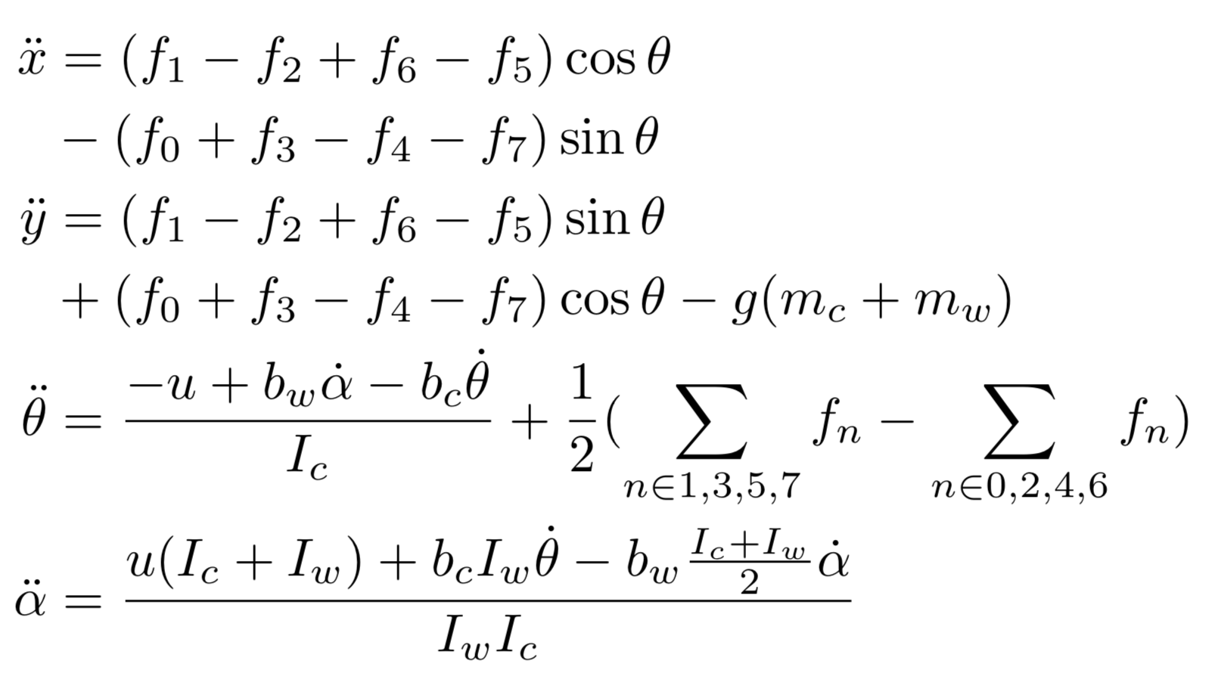
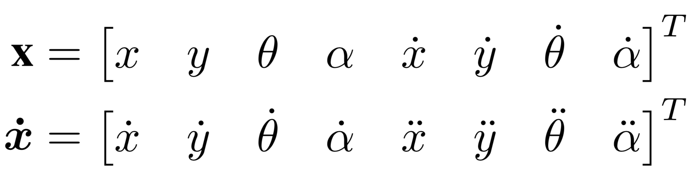
Optimization Formulation
2d floating-base coordinates

Slide 4
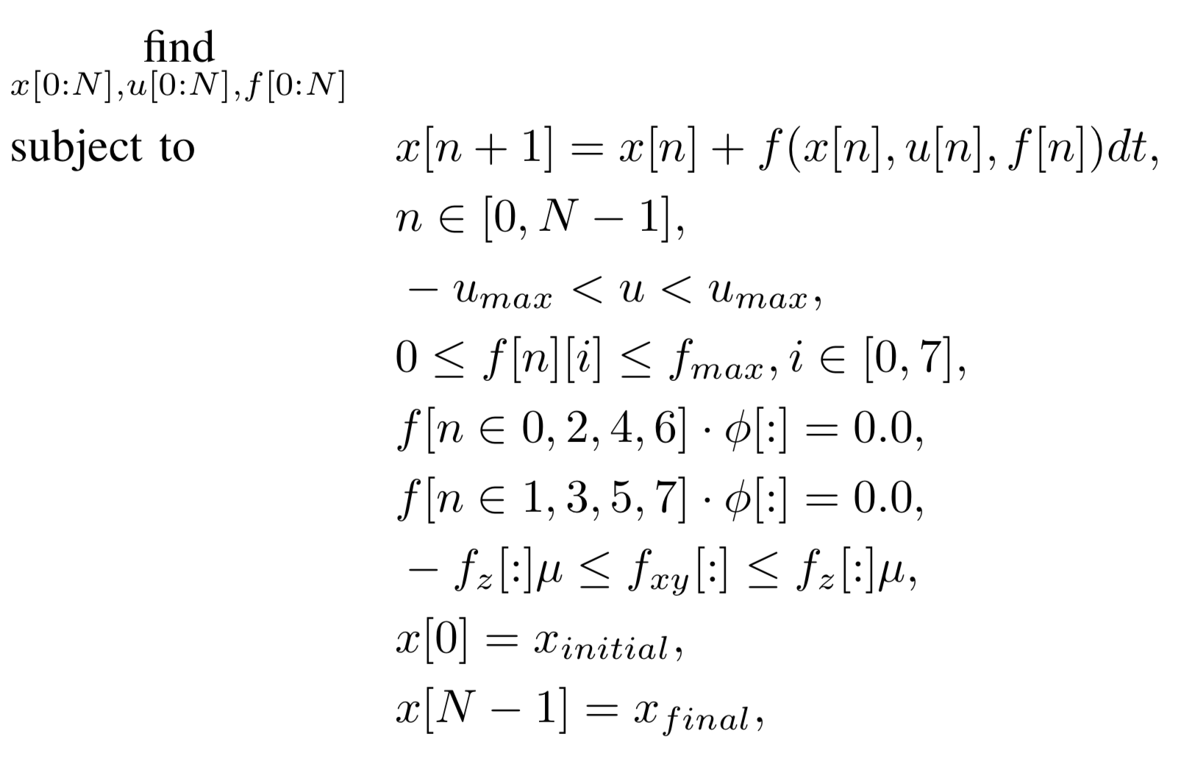
Optimization Formulation
Contact-implicit trajectory optimization

Slide 5
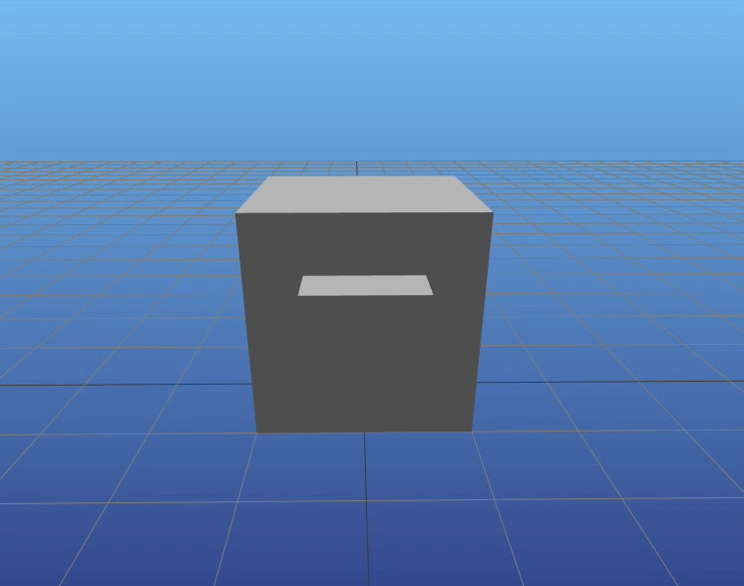
Swing Up
No objective function
No initial guess
Constrained corner position
Bound on height
Small slack thresholds

Slide 6
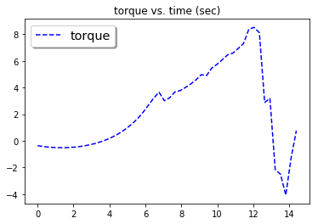
Swing Up

Slide 7
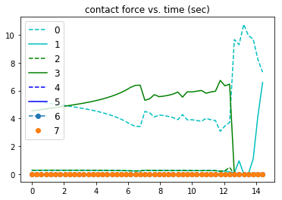
Swing Up

Slide 8
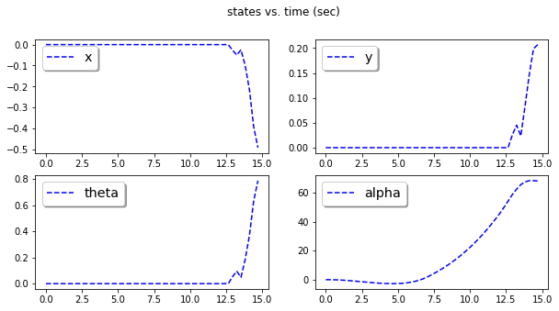
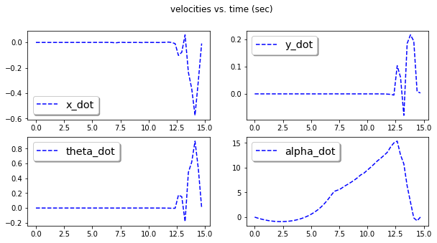
Swing Up

Slide 9
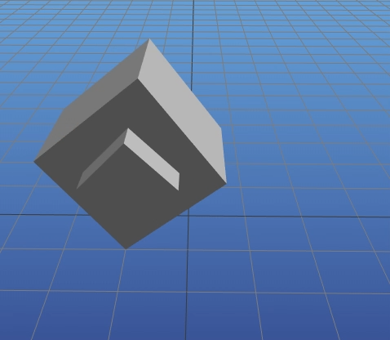
PD & QP Controller
Quadratic costs
Corner position
State velocities
PD control on theta
Contact-implicit forces

Slide 10
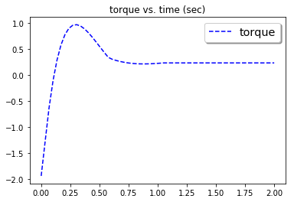
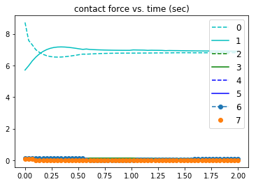
PD & QP Controller
Quadratic costs
Corner position
State velocities
PD control on theta
Contact-implicit forces

Slide 11
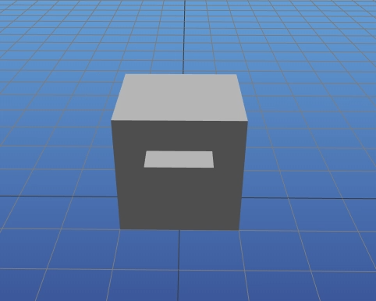
PD & QP Controller
Quadratic costs
Corner position
State velocities
PD control on theta
Contact-implicit forces
Swing up with controller and torque limits

Slide 12
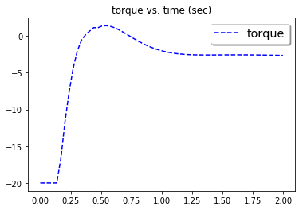
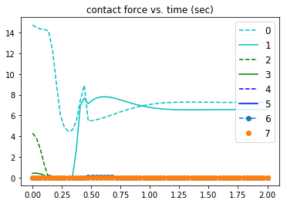
PD & QP Controller
Quadratic costs
Corner position
State velocities
PD control on theta
Contact-implicit forces
Swing up with controller and torque limits

Slide 13
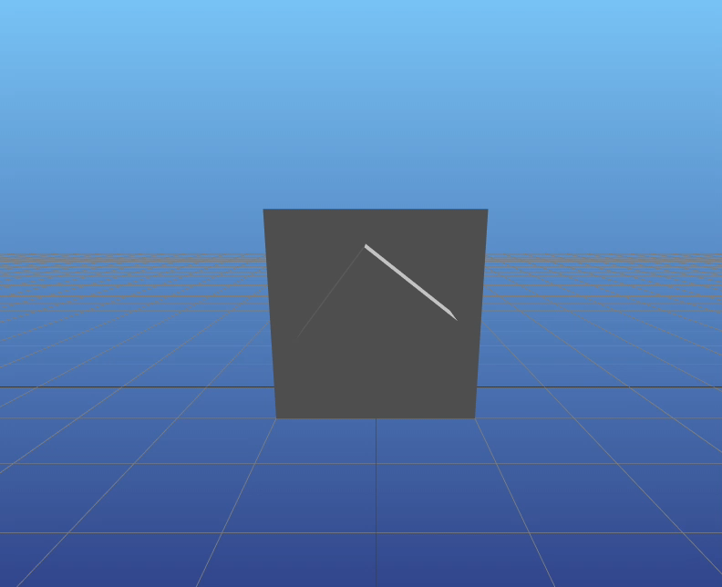
Limit Cycle
Objective functions
Minimize torque
Maximize velocity
Minimize time

Slide 14
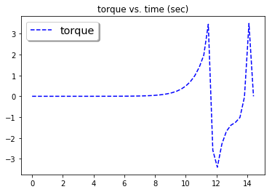
Limit Cycle
Minimize torque

Slide 15
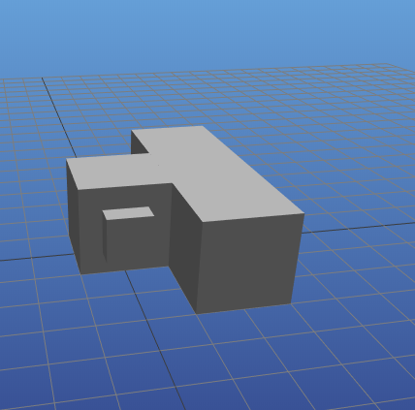
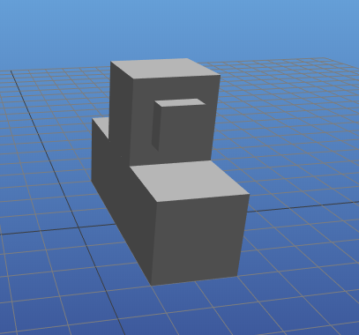
Goal: M-Blocks Example

Slide 16
Results and Future
Solving the same problem in different dimensions (# slack variables)
Some problems wouldn’t solve in 2d coordinates
Quadratic cost on corner position works well
Slack thresholds on floor position
Allow slight penetration
To do
Bound the search with RRT or other methods
Generate good initial guess

